Slide 1
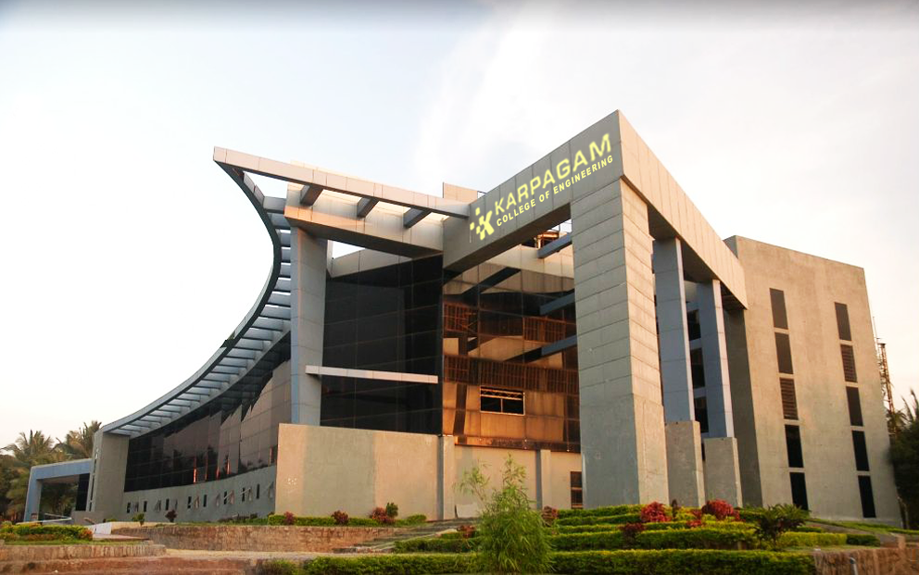

TITLE
Team details
Mr. xyz, 717821I...
Supervisor details

Slide 2
Abstract
Clear points

Slide 3
Objective
To…..
main three objectives

Slide 4
Literature Review
S.No | Paper Title and Year of Publication | Author Names | Merit | Demerit
 | 5 – Literature

Slide 5
Architecture diagram

Slide 6
Methodology - 1
Points

Slide 7

Methodology - 1 Result
Points
points
Expected Screenshot of Result

Slide 8
Methodology - 2
Points

Slide 9
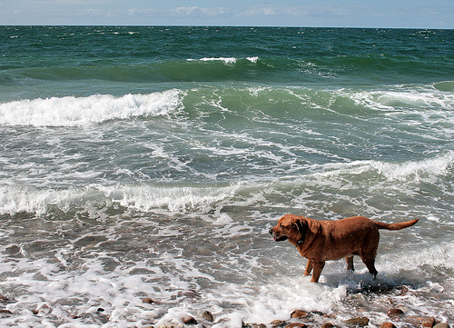
Methodology - 2 Result
Points
points
Expected Screenshot of Result

Slide 10
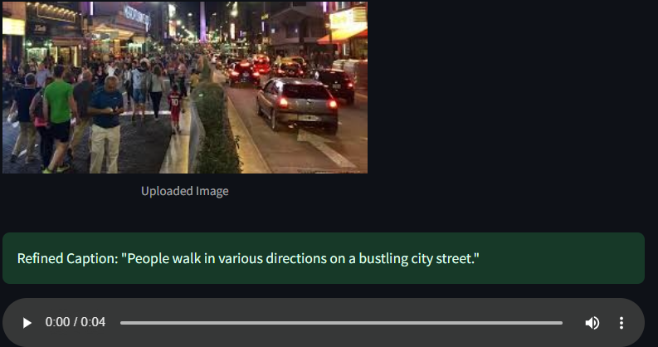

FINAL OUTCOME

Slide 11
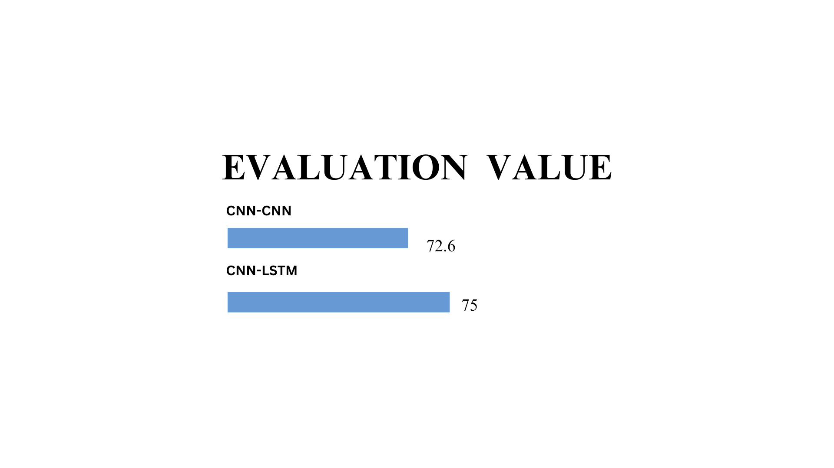
Comparison
SCORE
22-01-2025

Slide 12
Publication details
Points

Slide 13
REFERENCE
Antonio M. Rinaldi , Cristiano Russo, Cristian Tommasino [2023]. Automatic image captioning combining natural language processing and deep neural networks Elsevier., https://doi.org/10.1016/j.rineng.2023.101107
Reshmi Sasibhooshan, Suresh Kumaraswamy and Santhosh kumar Sasidharan [2023]. Image caption generation using Visual Attention Prediction and Contextual Spatial Relation Extraction, Springer, Journal of Big Data, https://doi.org/10.1186/s40537-023-00693-9
Aishwarya Maroju, Sneha Sri Doma, Lahari Chandarlapati, [2021]. Image Caption Generating Deep Learning Model, IJERT, Vol. No. 10, https://www.ijert.org/research/image-caption-generating-deep-learning-model-IJERTV10IS090120.pdf
Shuang Liu, Liang Bai, Yanli Hu and Haoran Wang, [2018]. Image Captioning Based on Deep Neural Networks, EDP Sciences, http://dx.doi.org/10.1051/matecconf/201823201052
Jiuxiang Gu, Jianfei Cai, Gang Wang and Tsuhan Chen [2018]. Stack-Captioning: Coarse-to-Fine Learning for Image Captioning https://ojs.aaai.org/index.php/AAAI/article/view/12266

Slide 14

Dept. of Artificial Intelligence and Data Science

